Slide 1
UNITED NATIONS GLOBAL GEODETIC
CENTRE OF EXCELLENCE
MODERNISING GEOSPATIAL REFERENCE SYSTEM
CAPACITY DEVELOPMENT WORKSHOP
Transformation parameters, plate motion models and deformation models
Nicholas Brown
Head of Office, UN-GGCE
Day 3, Session 1 [3_1_1]
HOW
Acknowledgements: Nic Donnelly (NZ); Jan Dostal (UN-GGCE); Anna Riddell (AUS); Chris Pearson (NZ); Alex Woods (AUS)

Slide 2
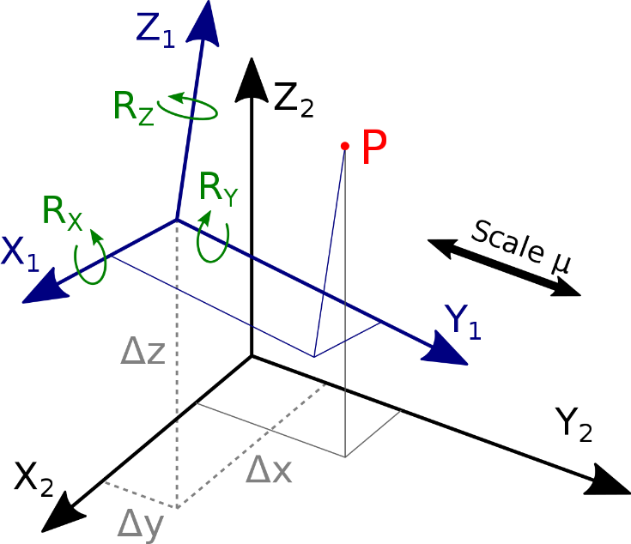
Different Reference Frames
Variety of Reference Frames
Different scale: global, regional, national, local
Different purpose: technical, scientific, cadastre
Deterioration over time due to the Earth’s dynamics
Technological evolution – increasing accuracy
Coordinate Transformation
Transformation (change) of the coordinates of a point defined in one reference frame to a different reference frame (e.g. from XYZ in ITRF1996 to XYZ in ITRF2020)
Common geodetic transformation parameters include:
Translation vector: The shift of the origin of the system
Rotation angles: The angle by which one system is rotated relative to another
Scaling: Resizing due to the different scales along the coordinate axis
STRONGER.
TOGETHER.
Notes:
Need speaker notes

Slide 3
Coordinate Transformation
Helmert Transformation equation
$$t_{x}$$
$$t_{y}$$
$$t_{z}$$
Scale (1)
Translation (3)
Rotation (3)
New
Coordinates
Original
Coordinates
7 Transformation parameters
Translation (3)
Rotation (3)
Scale (1)
STRONGER.
TOGETHER.
www.sli.do #AGRS
Notes:
The transformation between the two datums is carried out by the so called Helmert Transformation.
The points new X,Y,Z coordinates in the vector B on the left hand side of the equation result from the original coordinates of vector A on the right hand side of the equation - plus
the transformation parameters that are given through an rotation matrix (containing 3 parameters related to each axis), translation vector with another 3 parameters,
each for every of the three coordinate components,
and a coefficient MU for taking in account the different scale of the two different datums.
The graphic on the right displays the two different coordinates systems (in black and blue) in which the point P (in red) is described.
The rotation parameters of the three axis are marked in green, the point shift – the Delta XYZ - is displayed as well as the scale - the stretch factor.

Slide 4
Coordinate Transformation
Static Datum
New Geocentric Static Datum
Transformation
Connection between
two different Datums
*Use case – improved management of heights (ITRF1992 and ITRF2020 have a 9 cm difference in ellipsoidal height)
7 parameter transformation
Static Datum
Old Geodetic Static Datum
STRONGER.
TOGETHER.
Notes:
Doesn't satisfy the old datum the given requirements, new datum is created at first independently the same way we already explained before.
For this purpose we have to use also sites included in the old datum.

Slide 5
Transformation Parameters
Estimation of the Transformation Parameters
Common Points in OLD and NEW static datum (minimum three points)
Inversion of the Helmert Transformation equation
Example
Marker in Old Static Datum
STRONGER.
TOGETHER.
www.sli.do #AGRS
Notes:
Before starting using the Helmert transformation equation for a particular transformation between two given datums, the 7 transformation parameters have to be estimated.
For this we need common points that have known coordinates in both datums as well as an inversion of the Helmert transformation equation to solve the problem.
The graphic on the right represents with the red crosses a survey marker in one static datum.

Slide 6
Transformation Parameters
Estimation of the Transformation Parameters
Common Points in OLD and NEW static datum (minimum three points)
Inversion of the Helmert Transformation equation
Example
Marker in Old Static Datum
Marker in New Static Datum
STRONGER.
TOGETHER.
www.sli.do #AGRS
Notes:
Now we include in the graphic with the blue dots survey markers in the new static datum.
And now marked in green you see that some points have a coordinates in both static datums – points with red cross and blue dot.
These common points can be used for the estimation of the 7 parameters.

Slide 7
Coordinate Transformation
Original Coordinates
Latitude, Longitude, ell. Height
Cartesian Coordinates (X,Y,Z)
Transformation using parameters
Cartesian Coordinates (X,Y,Z)
New Coordinates
Latitude, Longitude, ell. Height
STRONGER.
TOGETHER.
www.sli.do #AGRS
Notes:
Once the transformation parameters between two static datums are known, any location can be described in both datums.
Here we describe how it works in praxis:
Usually we start with point description in latitude, longitude and height in the original datum
First we convert this coordinates in cartesian system representation – means in X,Y,Z vector
Than we transform the coordinates in the other datum, and
At the end we convert the coordinates again in the latitude, longitude and height representation of the new datum

Slide 8
Coordinate Transformation (with deformation)
Static Datum
New Geocentric Static Datum
Transformation + Deformation
Connection between
two different Datums
7 parameter transformation
+deformation model
Static Datum
STRONGER.
TOGETHER.
Old Geodetic Static Datum
Notes:
Doesn't satisfy the old datum the given requirements, new datum is created at first independently the same way we already explained before.
For this purpose we have to use also sites included in the old datum.

Slide 9
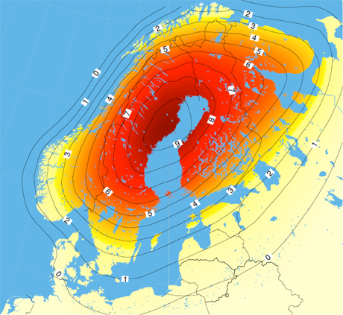
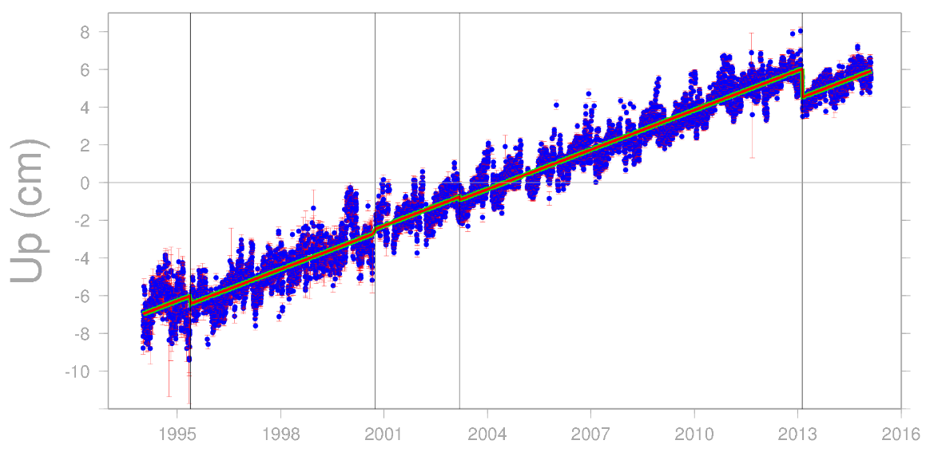
1D Postglacial Land Uplift
GNSS station Kiruna
Land uplift 7 mm / yr
1995
2004
2016
STRONGER.
TOGETHER.
9
Notes:
But first we look at another phenomenon.
During the ice ages the huge mass of ice accumulated over Scandinavia pressed the Earth crust down.
After the ice melted the elastic crust started to move back to its original position.
This is what we call the Postglacial Land Uplift.
With the red coloring in the figure on the left is indicated the area of such land uplift over Scandinavia.
In the graph on the right, you see then the uplift rate for the particular GNSS station Kiruna, which has the average uplift rate of 7 mm per year.
Such land uplift with the rate of around 1 cm per year over the large area could not be seen without a precise vertical datum.

Slide 10
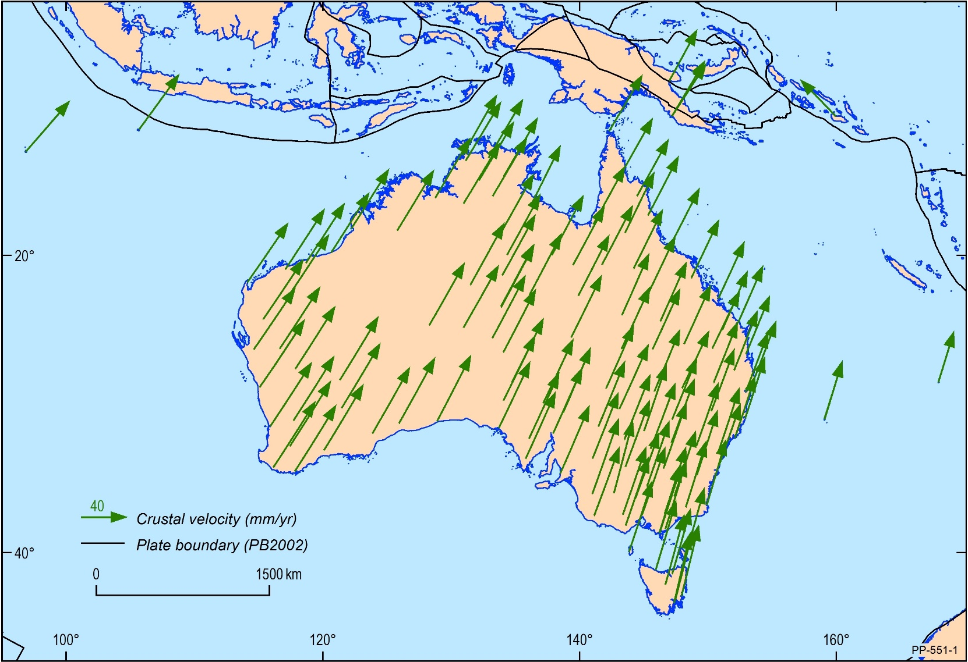
2D modelling
Secular motion
Australia is the fastest moving continental plate (~7 cm/yr NNE)
GNSS provides coordinates in ITRF (position of Australian plate now)
Users would see ~1.8 m mismatch between GNSS positions and spatial datasets (if in GDA94).
STRONGER.
TOGETHER.
www.sli.do #AGRS

Slide 11
2D Plate Motion Model
The Australia continent is relatively free from deformation with the cumulative horizontal deformation from great earthquakes found to be <0.2 mm/yr (Tregoning et al. 2013).
The motion of the continent can be modelled by a clockwise rotation about a Euler pole. The instantaneous velocity of this rotation results in, what appears to be, a linear motion of ~7 cm/yr in a north-northeast direction, with locations further from the pole moving faster than those closer.
The Australian Plate-Motion Model (PMM) was created through analysis of the APREF solution, which showed that the horizontal stability of APREF stations is 1 mm/yr or less.
The Australian PMM can be used to propagate coordinates between ITRF2014 at any epoch and GDA2020 (and vice versa).
Denser and more accurate version of the ITRF2014 velocity model for Australia.

Slide 12
+
GDA2020 = ITRF2014@2020
ITRF2014 coordinates are different to ITRF1992 coordinates
e.g. heights are 9 cm different
Why don’t they match?
Changes in the reference frame between the ITRF1992 and today
Local distortions (e.g. subsidence, earthquakes)
Lack of rigour in the way GDA94 coordinates were computed
~7 cm / yr
Updates to ITRF; 1994, 1996, 1997, 2000, 2005, 2008, 2014.
Each is an improved realisation of the shape of the Earth
7 parameter
transformation
+
+
ITRF1992@1995.0 (~7 cm NNE of 1994)
GDA94 = ITRF1992@1994.0
STRONGER.
TOGETHER.
www.sli.do #AGRS

Slide 13
2D Deformation modelling
Distortion in GDA94
Changes in the reference frame between the ITRF1992 and today
Local distortions (e.g. subsidence, earthquakes)
Lack of rigour in the way GDA94 coordinates were computed
ITRF1992 @ 1994.0
Updated to 21 points in April 2012
GDA94
Adjustments
STRONGER.
TOGETHER.
www.sli.do #AGRS
Notes:
These vectors show the offset between GDA94 as established in 1997 compared to ITRF coordinates observed in 2010 transformed back to 1994
Majority of errors in the order of 10 – 20 cm but extend to 30 cm.
local distortions (e.g. subsidence, surface heave)
poor uncertainty propagation down to the marks in the original adjustment (particularly around relative uncertainty)
changes in the reference frame between the ITRF 1992 and today
The implications for errors introduced for big data surveys like LiDAR start to become relevant. When assessing data, how do you know whether the uncertainty is in the survey data or in the datum?

Slide 14
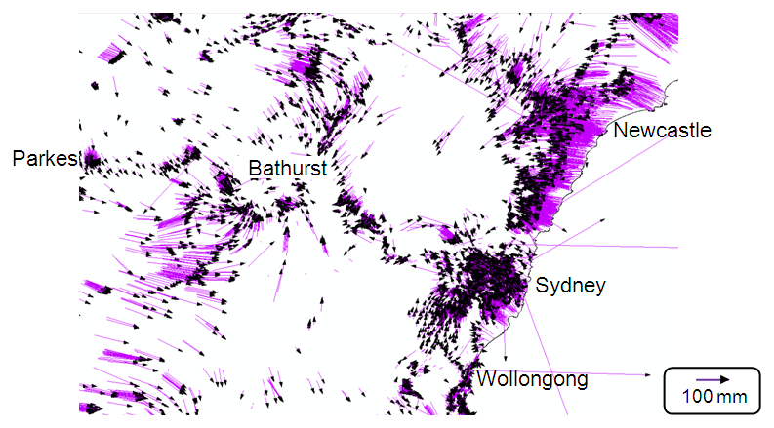
2D Deformation modelling
Distortion in the Geocentric Datum of Australia 1994
Changes in the reference frame between the ITRF1992 and today
Local distortions (e.g. subsidence, earthquakes)
Lack of rigour in the way GDA94 coordinates were computed
Source: Joel Haasdyk and Tony Watson, LPI NSW, APAS Conference 2013
www.sli.do #AGRS
Notes:
These vectors show the offset between GDA94 as established in 1997 compared to ITRF coordinates observed in 2010 transformed back to 1994
Majority of errors in the order of 10 – 20 cm but extend to 30 cm.
local distortions (e.g. subsidence, surface heave)
poor uncertainty propagation down to the marks in the original adjustment (particularly around relative uncertainty)
changes in the reference frame between the ITRF 1992 and today
The implications for errors introduced for big data surveys like LiDAR start to become relevant. When assessing data, how do you know whether the uncertainty is in the survey data or in the datum?

Slide 15
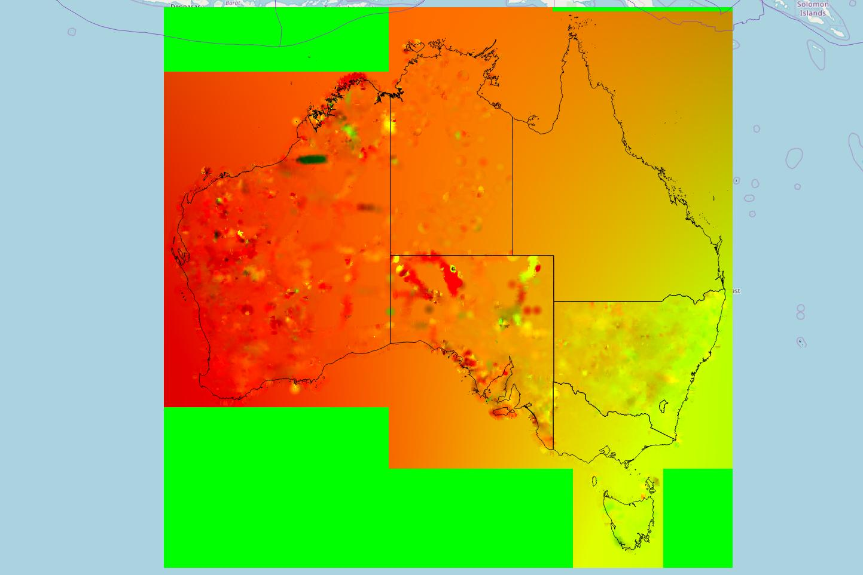
2D Conformal + Deformation Grid
Input:
Conformal grid
Survey marks
Published GDA94
Adjusted GDA2020
Application:
2D
Data aligned with survey control mark network
Courtesy of Alex Woods, DELWP
www.sli.do #AGRS

Slide 16
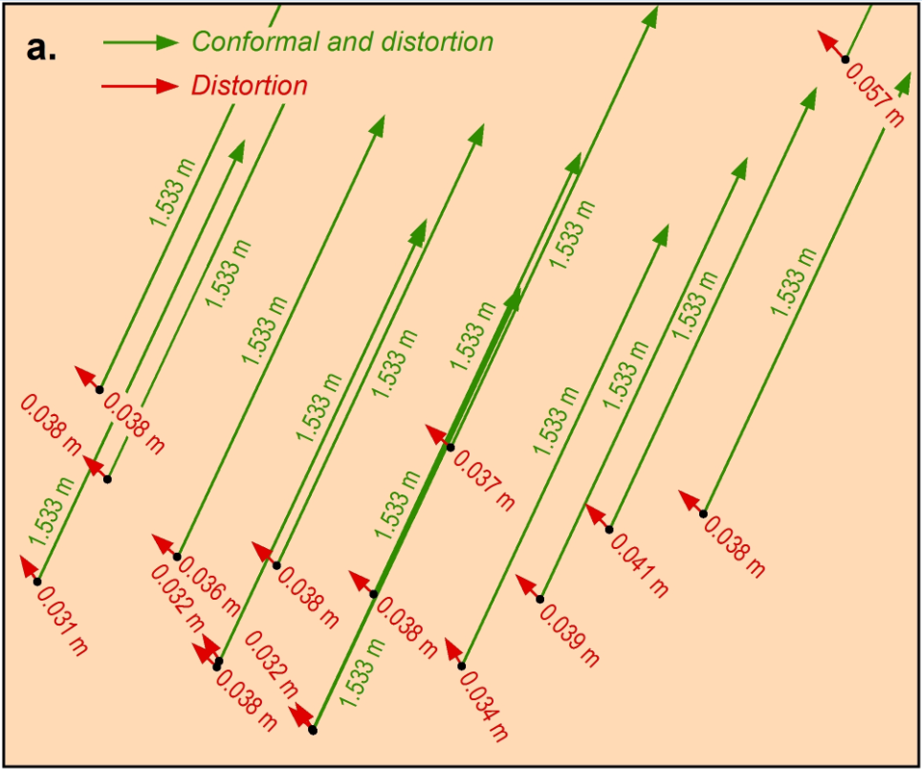
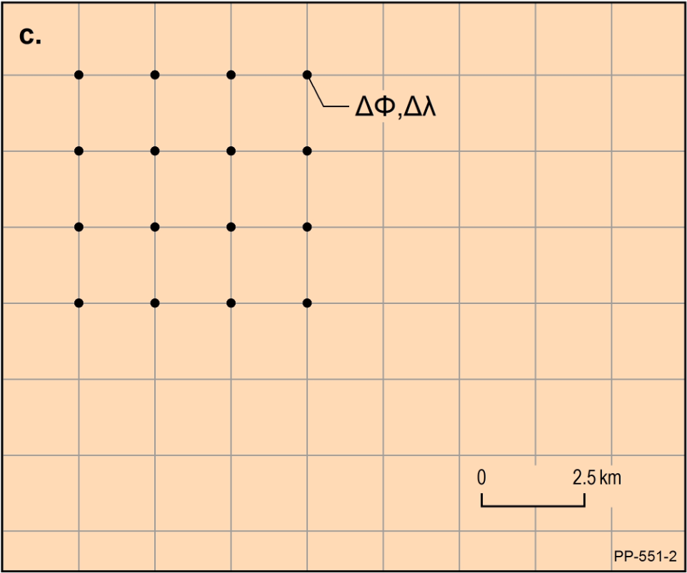
2D Conformal + Deformation Grid
conformal (green) and distortion (red) components of the transformation grids;
low reliability of distortion component;
the grid has a latitude component and longitude component.
www.sli.do #AGRS

Slide 17
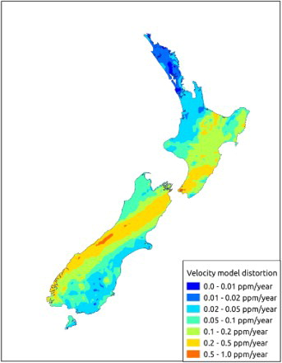
3D Deformation modelling
Deformation models are used to estimate:
The deformation of the Earth's crust, including tectonic movements, fault lines, and earthquakes.
New Zealand (NZGD2000) is defined through its relationship to ITRF via the deformation model.
STRONGER.
TOGETHER.

Slide 18
3D Deformation modelling
 | Reverse Patch | Forward Patch
Description | A reverse patch corrects coordinates in the past to account for deformation that has occurred since a specific reference epoch. | A forward patch projects coordinates into the future or corrects them to the present to reflect ongoing deformation.
Purpose | To adjust historical coordinates (e.g., survey data collected years ago) to align with the modern NZGD2000 reference frame, which represents the Earth’s surface at a specific reference epoch (2000.0) | To adjust current or past coordinates to account for crustal movement that will occur (or has occurred) after the reference epoch (2000.0) to align them with their real-world position.
Scenario | Suppose coordinates were measured in 2012. To use them in the NZGD2000 frame as it was in 2000, a reverse patch is applied to "undo" the tectonic movement that occurred between 2000 and 2012. | If a survey is conducted today (e.g., in 2025), the coordinates would need a forward patch to "predict" the movement since the 2000.0 epoch.
Usage | Typically applied when integrating older datasets into a modern geodetic framework or when comparing historical data with present-day coordinates. | Essential for applications like real-time GNSS positioning, where coordinates need to reflect the current Earth's surface rather than the 2000.0 reference frame.
STRONGER.
TOGETHER.

Slide 19
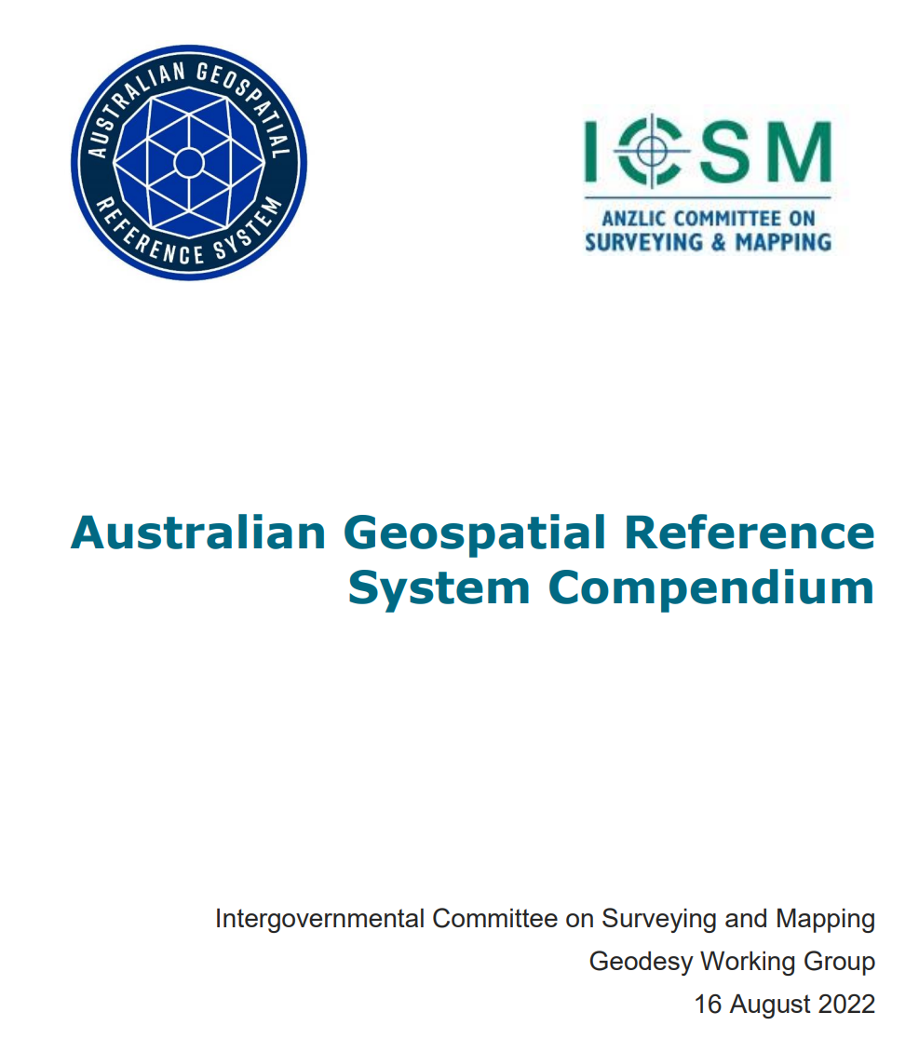
Resources
https://github.com/GeoscienceAustralia/GeodePy
https://www.icsm.gov.au/sites/default/files/2022-08/AGRS_Compendium_20220816.pdf

Slide 20
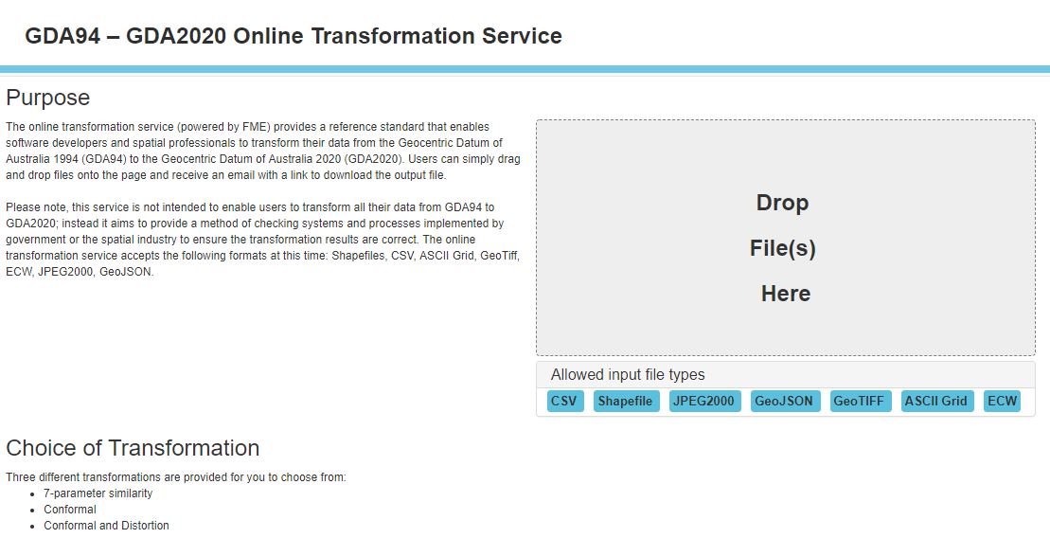
Transformation Service
http://positioning.fsdf.org.au/
https://github.com/GeoscienceAustralia/GeodePy
https://www.epncb.oma.be/_productsservices/coord_trans/
www.sli.do #AGRS
Notes:
For the described coordinate transformation different online tools exist.
These transformation services are free of charge to use.
Usually a file of coordinate list can be uploaded and converted.
On the left side you see the Australian tool for the transformation from the Geocentric Datum of Australia 1994 (GDA94) into the Geocentric Datum of Australia 2020 (GDA2020).
On the right side an European tool to transform between different epochs of the European Terrestrial Reference Frame is presented.

Slide 21
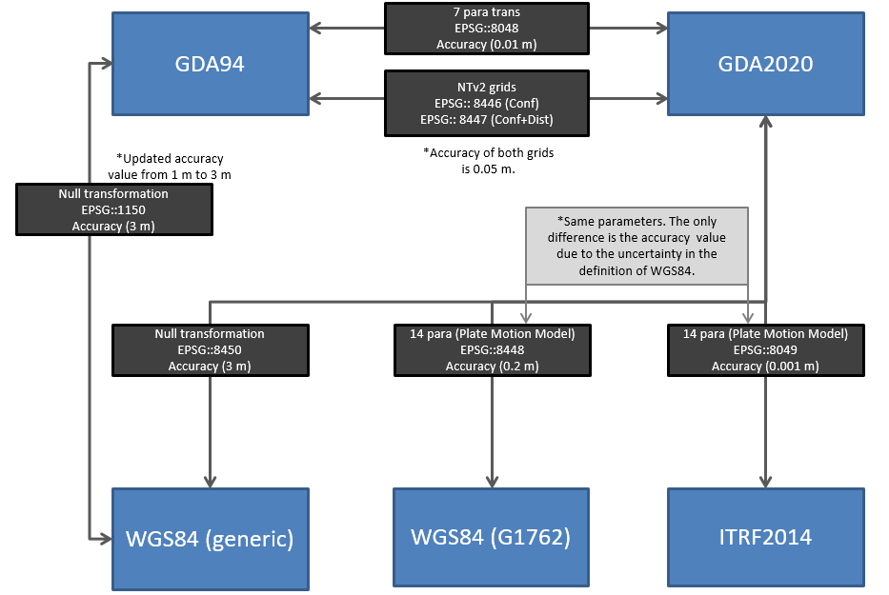
Current status
Update accuracy of GDA94-WGS84(generic) EPSG code (1150) from 1 m to 3 m
Introduction of GDA94-GDA2020 EPSG codes
Introduction of GDA2020-ITRF2014 EPSG code (8049)
Future
Discussions with OGC+EPSG to recognise WGS84 as time-dependent
www.sli.do #AGRS

Slide 22
Coordinate Transformation
Alice Springs (ALIC) – 7 parameter transformation GDA94 GDA2020
Original Coordinates
Latitude, Longitude, ell. Height
-23° 40’ 12.446019’’ 133° 53’ 07,847844’’ 603.3466
-23.6701239° 133.8855133° 603.3466
Cartesian Coordinates (X,Y,Z)
-4052051.7643 4212836.2017 -2545106.0245
Difference
in coordinates
Latitude Longitude ell. Height
Transformation using parameters
0.04952’’ 0.02995’’ -0.0977’’
X[m] Y[m] Z[m]
1.5236 0.8487 -0.0977
Cartesian Coordinates (X,Y,Z)
-4052052.7379 4212835.9897 -2545104.5898
New Coordinates
Latitude, Longitude, ell. Height
-23.6701101° 133.8855216° 603.2489
-23° 40’ 12.39650’’ 133° 53’ 07,87779’’ 603.2489
STRONGER.
TOGETHER.
www.sli.do #AGRS
Notes:
On the right you see now also a numerical example for CORS station in Alice Springs by transformation from Australian static datum GDA94 into new Australian static datum GDA2020.
The numerical difference in the coordinates is shown in red.
#######################################
GDA - Geocentric Datum of Australia

